Slide 1
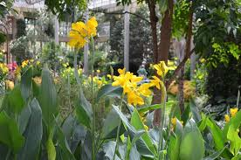
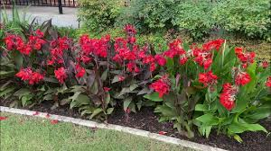
CANNA LILY FLOWER
Near Pre-primary play area AIS Campus, Wakad.

Slide 2
Common Name : Canna Lily , Kardal, Indian shot Scientific Name : Canna indica Family : Cannaceae Habit : Cannas or Canna lilies are perennial plants known for their bold-tropical like foliage and large, vibrant blooms that may be red, orange, or yellow and in the family Cannaceae, they are the only one consisting of 10 species. They have large banana-like leaves. Their insane height structure, and strong ornamental interest contributes as a great addition to the garden. Distribution : These are native to the American tropics and naturalised in Europe, India and Africa, the Caribbean, Mexico.

Slide 3
Description :
Leaves: Canna lilies have large, broad, flat, alternative leaves that grow out of a long-rolled stem that unfurls. They are typically solid emerald green, but can be of maroon, brownish, etc., too. They are asymmetric and composed of three sepals, petals hidden under elegant stamens.
Height: They have a strong upright growth habit. Mostly, they grow between 3-5 feet tall, and some can even grow up to 8 feet!
Flowers: Cannas take about three months to develop flowers after planting, and after blooming lasts a couple of days. They can of red, orange, white, yellow or pink. They successively bloom during summers and often in October.
Fruits: The fruit is usually a capsule or pod, 1.5 to 3 cm long, with seeds in it which are green, spiky, round structures containing one to three seeds.
Growth: Best flowering occurs in full sun, rich, moist and well drained soils or moderate conditions.
Lifespan: The flowers may last for few days but the plant lasts for 3-5 years or more.

Slide 4
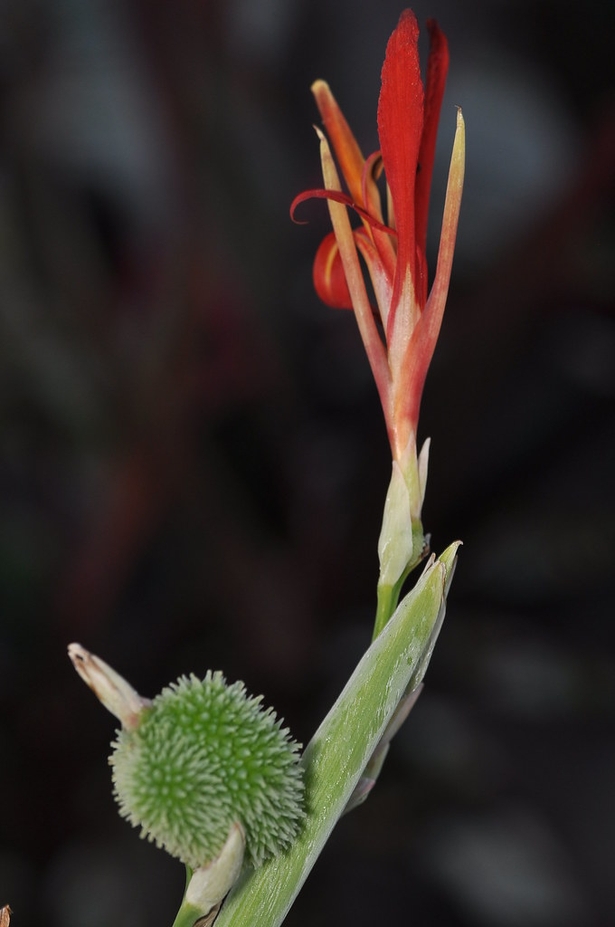
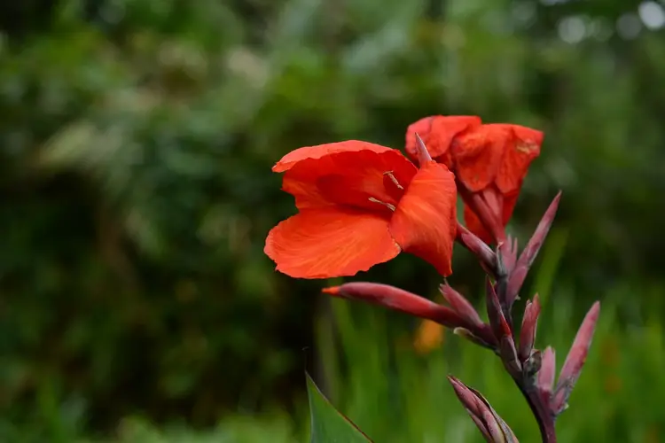
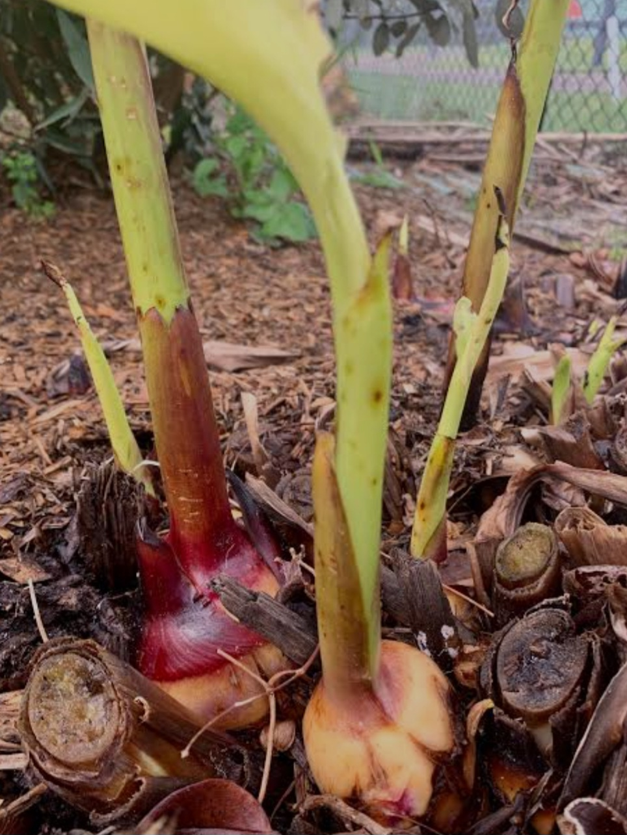
Uses

Slide 5
Medicinal use: Canna can be used to treat menstrual pains. The root can be used to treat gonorrhea and amenorrhoea. In Nigeria, people turn the root into a powder and ingest it to treat diarrhea and dysentery . They also use the flowers as a medicine for malaria.
Seeds:
The seeds are used as beads in jewelry.
The seeds are used as the mobile elements of the kayamb, a musical instrument from Réunion, as well as the hosho, a gourd rattle from Zimbabwe, where the seeds are known as hota seeds.
Flowers:
The main pollinators of the flowers are bees, hummingbirds, sunbirds, and bats. The pollination mechanism is conspicuously specialized. Pollen is shed on the style while still in the bud, and in the species and early hybrids, some is also found on the stigma because of the high position of the anther, which means that they are self-pollinating.
Commercial Value: All of the plant material has commercial value, rhizomes for starch (consumption by humans and livestock), stems and foliage for animal fodder, young shoots as a vegetable, and young seeds as an addition to tortillas.

